Slide 1

Welcome To my Presentation

Slide 2
My Information
Name:
Roll :
Shift:
Semester:
Institute Name:

Slide 3
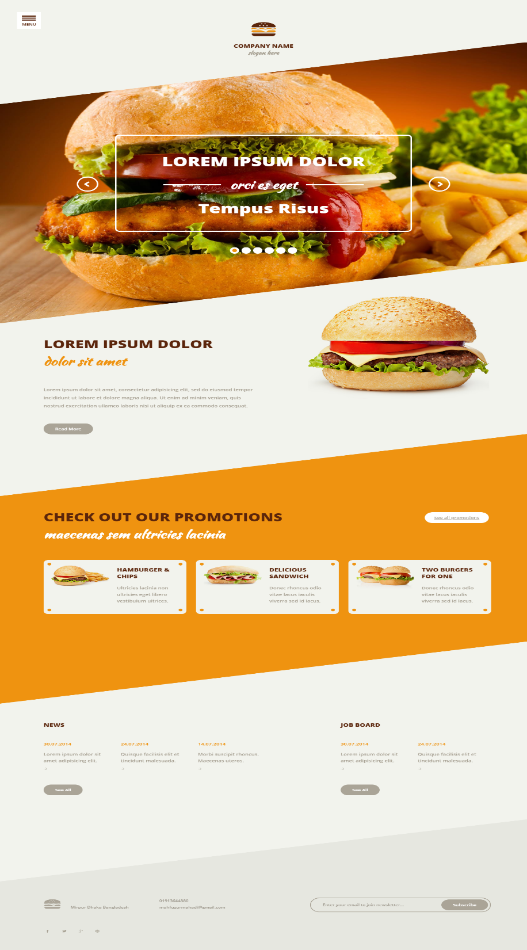
project: burger bar

Slide 4
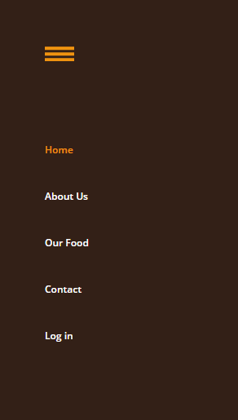
Menu and Header section

Slide 5
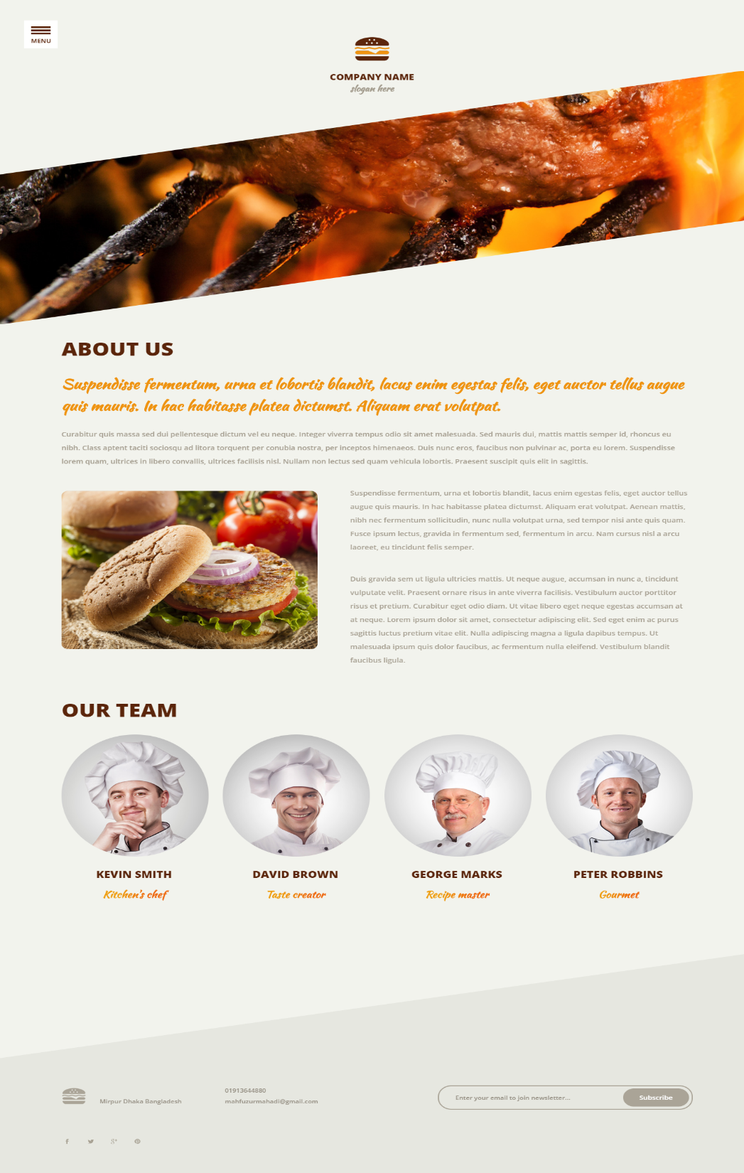




About section

Slide 6
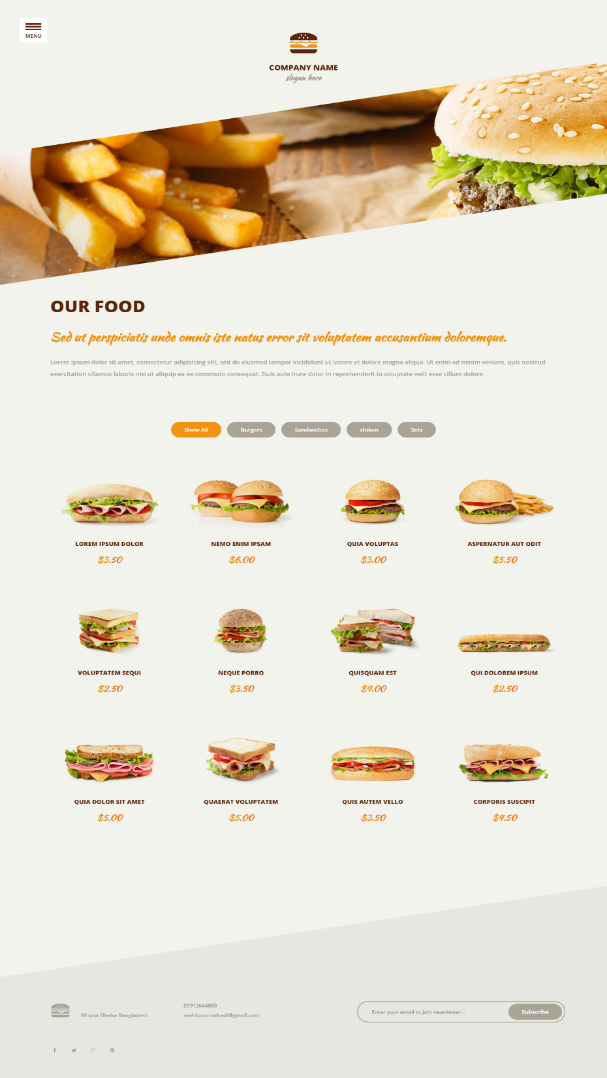
Our foods

Slide 7
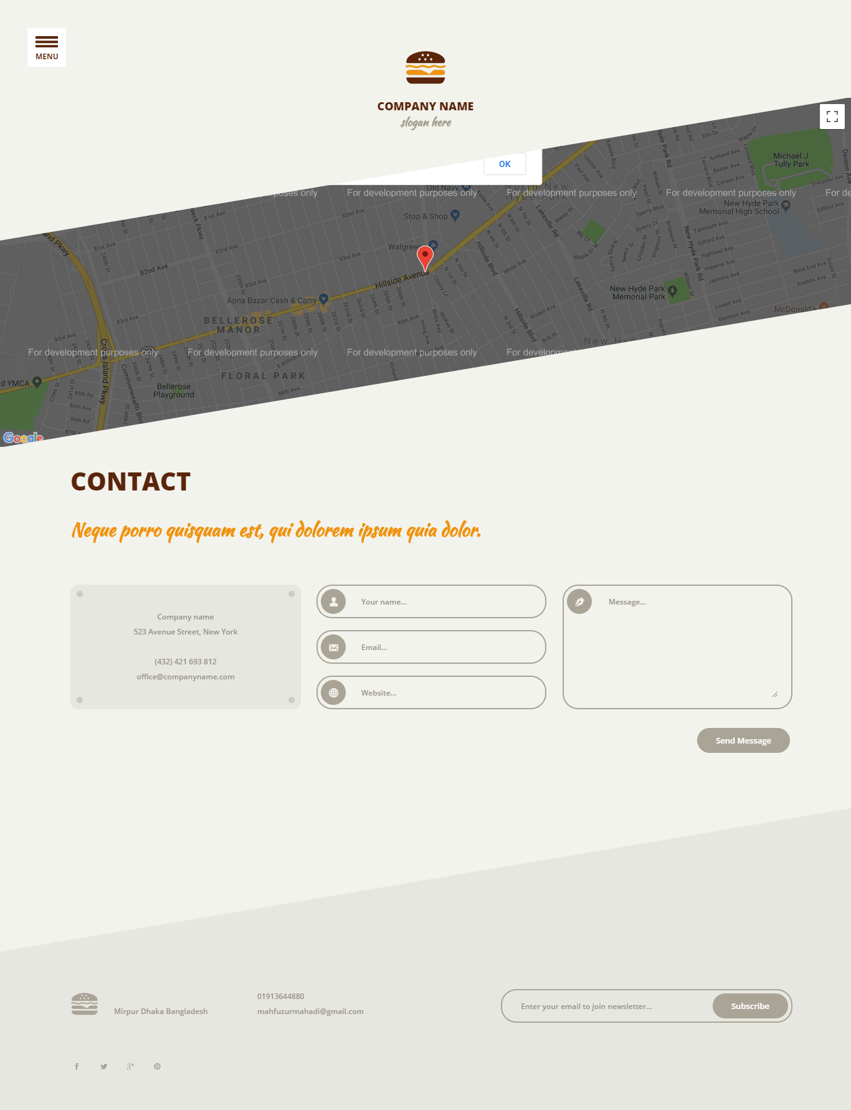
contact

Slide 8
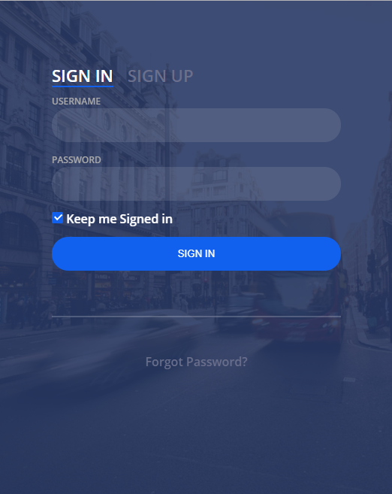
REGISTRATION

Slide 9


Tools for this project
Sublime Text Editor
Chrome Browser

Slide 10
Thanks for watching

